Slide 1

BANK LOAN DEFAULT GROUP-4 MENTOR-KARTHIK, DILEEP 08/08/2020

Slide 2
SUMMARY
A Bank accepts deposits from customers and from the corpus thus available, it lends to Borrowers who want to carry out certain Business activities for Growth and Profit. It is often seen that due to some reasons like failure of Business, the company making losses or the company becoming delinquent/bankrupt the loans are either not Paid in full or are Charged-off or are written off. The Bank is thus faced with the problem of identifying those Borrowers who can pay up in full and not lending to borrowers who are likely to default.

Slide 3
BUSINESS PROBLEM
The objective of the analysis is to predict whether the customer would default on the loan or not.

Slide 4
PROJECT ARCHITECTURE
PROBLEM DEFINITION
DATA GATHERING
DATA CLENSING
EXPLORATORY DATA ANALYSIS
FEATURE ENGINEERING
MODEL BULIDING
MODEL SELECTION
DEPLOYMENT

Slide 5
EXPLORATORY DATA ANALYSIS

Slide 6
DATA SET DETAILS
Null Values
Number of records:1,49,999
Number of features:26
Unique Values
Feature | Count
Name | 8
City | 1
State | 2
Bank | 147
BankState | 148
RevLinecr | 23
ChgOffDate | 109533
DisbursementDate | 225
MIS_Status | 868
Feature | Count
Name | 140884
City | 15793
State | 52
NewExist | 3
UrbanRural | 3
RevLineCr | 8
LowDoc | 4
MIS_STATUS | 3

Slide 7
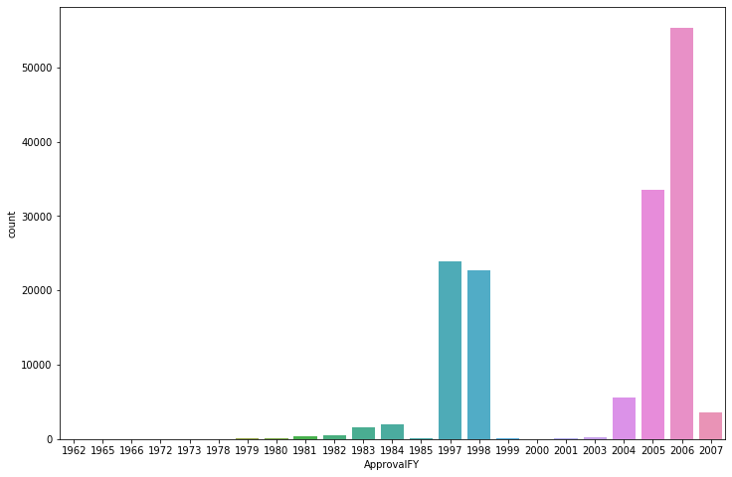
EDA
MIS_STATUS represents the output of the problem statement, hence target variable named default is created by mapping values from MIS_STATUS.
About 35% of the businesses will default.
The year of approval varies between 1962 and 2007 and the disbursed amount between $0 and $4,029,520.
More defaulters in 1997-1998 and 2005-2006
If the loan is approved before 1982, there is
high chance to default; if between
1997-2003, very less chance to default.

Slide 8
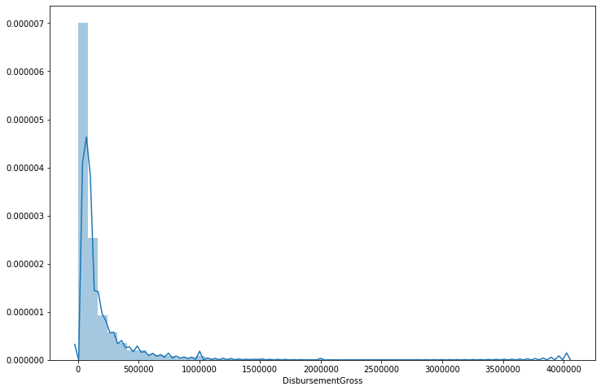
EDA
The disbursed amount is right skewed i.e. more cases are having
very less amount. As Disbursement Gross increases, chances
of defaulting decreases
Existing businesses have a marginally more chance to default
than new businesses.
5260 businesses have franchises and defaulting chances are
less for businesses with franchises.
Urban business more likely to default than rural businesses
If covered under LowDoc, then very unlikely to default.
Loans for 0-5 and 30-40 month term has more chance of defaulting, and 5-30 month term less chance of defaulting
As the number of employees in the business increase, chances of defaulting decreases.
Chances of defaulting is least when jobs created is between 10 and 400, highest when greater than 400
If no jobs retained, defaulting is very less, then the chances of defaulting comes down as the jobs increases

Slide 9
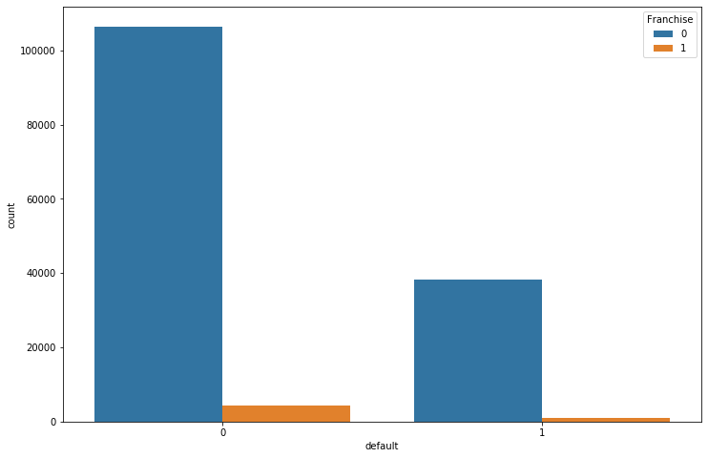
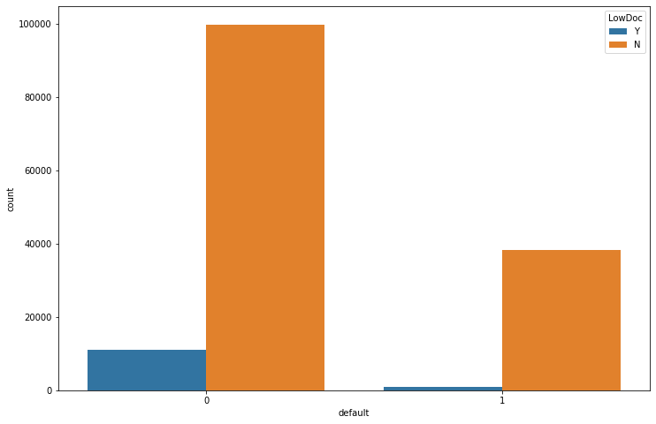
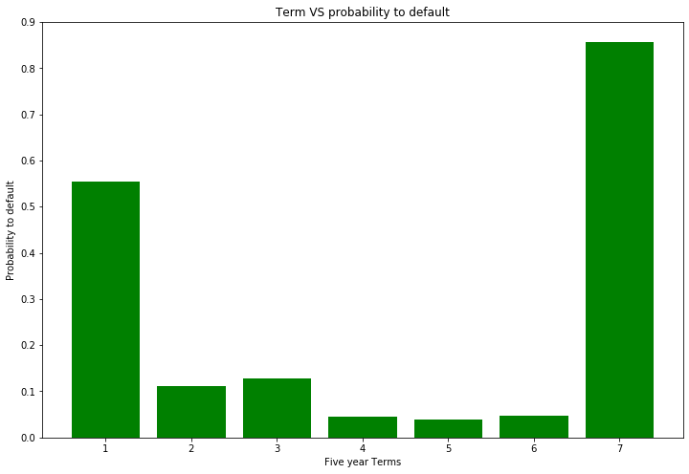
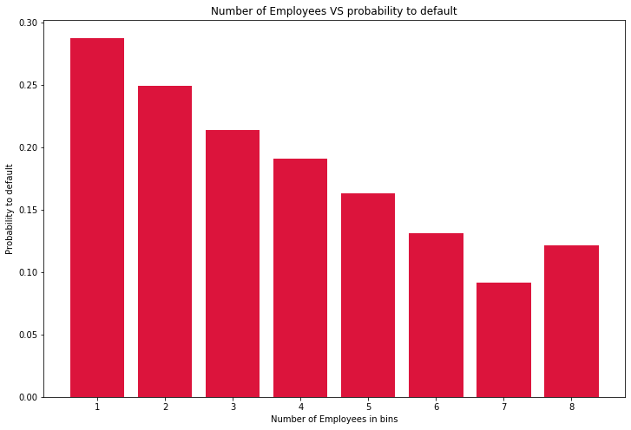
EDA

Slide 10
MODEL BUILDING

Slide 11
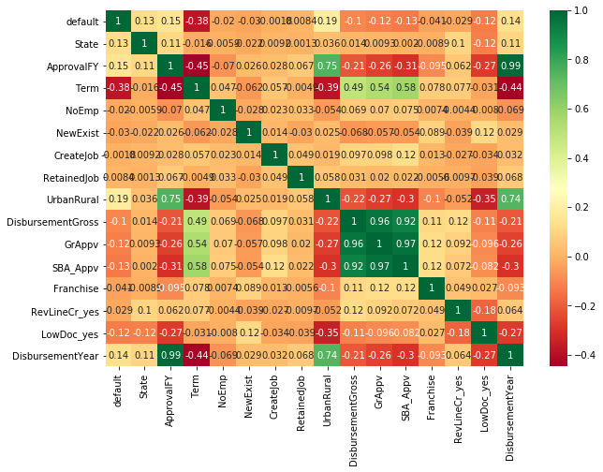
HEATMAP
Feature Selection done by visualizing the heatmap as well as the feature importance scores of ExtraTreesClassifier

Slide 12
TRAINED MODELS
MODEL | TRAIN ACCURACY | TEST ACCURACY
Logistic Regression | 83.28% | 83.28%
KNN | 89.42% | 89.71%
SVM | 88.88% | 88.70%
Decision Tree | 99.99% | 91.85%
Random Forest | 99.99% | 94.07%
XGBoost | 96.04% | 94.9%

Slide 13
MODEL SELECTION
XGBoost Model chosen as it had highest accuracy scores
Hyperparameter Tuning done on XGBoost model which marginally increased the accuracy
Trained the model on the whole dataset

Slide 14
Model Deployment using Flask and Heroku

Slide 15
Model Deploy Procedure
Created Proc file to declare process type.
Requirement.txt file was created with all libraries in it.
Templates file was created to store html file.
GitHub repository was created and all files required for deploy where uploaded.
Created Heroku account and linked GitHub repository in order to deploy app.
https://loan-default-pred-api.herokuapp.com/

Slide 16
Challenges Faced
Creating dummy variables for the State feature which had 50 unique values.
For loops user for feature engineering were time consuming.
Hyperparameter tuning using RandomizedSearch CV did not increase accuracy.
Faced technical errors while deploying in Heroku.
How did we overcome?
Mean encoding done on State column.
Replaced for loops with functions.
Manually tuned main parameters.
Removed the extension of the Proc file.

Slide 17
THANK YOU

